Slide 1
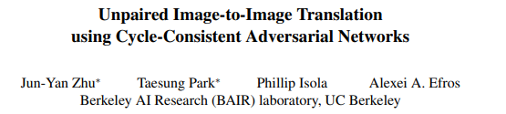
CycleGAN

Slide 2
About the paper
Published at the IEEE conference.
9341 citations.

Slide 3
About the main authors
Jun-Yan Zho : Professor in Carnegie Mellon University.
Taesung Park : Professor in Berkeley University.

Slide 4
Introduction: Image-To-Image translation
Image to image translation is a task where we generate an image with a specific modification, given some other image.
For example:
Summer landscapes → Winter landscapes
Segmented mask → Real photo
Real images → artistic styled paintings, and more…
This task mainly requires a big dataset of paired-images, which is a very hard demand to achieve at most cases.

Slide 5
Unpaired image to image translation
CycleGAN requires a softer demand – a dataset of images from 2 different domains X and Y.
CycleGAN doesn’t require the pair dependency between images from the different domains.

Slide 6
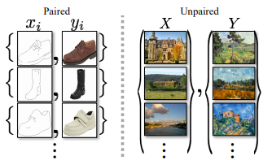
Quote from original paper:
“ We present a method that can learn to capture special characteristics of one image collection and figuring out how these characteristics could be translated into the other image collection, all in the absence of any paired training examples.

Slide 7
The Assumptions to achieve our goal:
There is some underlying relationship between the domains, for example, that they are two different renderings of the same underlying scene (Seasonal landscapes and etc…) and we seek to learn that relationship.
Although we lack supervision in the form of paired examples, we can exploit supervision at the level of different domains X and Y.

Slide 8
Why not just using vanilla GANs?
We may train a mapping G:X -> Y such that the output is indistinguishable from images .
In theory, we can achieve output distribution over y-tag that matches the empirical distribution Pdata(y).
However, such a translation doesn’t guarantee that individual input x and output y are paired up in a meaningful way.

Slide 9
Solving these issues
Exploiting the property that translation should be “cycle consistent”, in the sense that if we translate for example:
English term → French term → The same English term.
More formally:
given translators and .
Then G and F should be inverses of each other and be bijections, and we apply Cycle-Consistency loss that encourages:

Slide 10
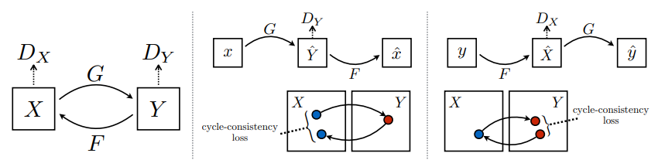
Cycle consistency Loss
Our model contains two mappings:
and discriminators Dy & Dx, where Dy encourages G to translate X into outputs indistinguishable from domain Y.
To capture the cycle-consistency idea we apply two cycle-losses:
1. Forward:
2. Backward:

Slide 11
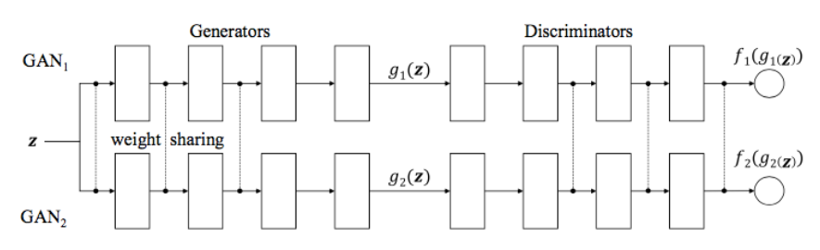
Some previous work – Image2image translation
CoGAN & Cross-modal scene networks – using the idea of learning joint distribution by sharing weights (Unpaired).
Pix2Pix – Using conditional GAN (Paired).

Slide 12
CycleGAN Architecture

Slide 13
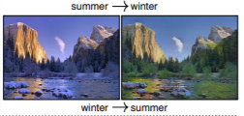
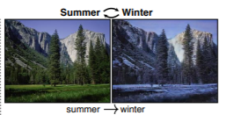
CycleGAN - Architecture
Let’s consider the next problem – landscape stylization from summer to winter, with unpaired domains.
We have Collection 1 – Summer landscapes, and Collection 2 – Winter landscapes.
The model contains 2 GANs where each is responsible for generating it’s own styled images, GAN 1 for summer and GAN 2 for winter.

Slide 14
Each GAN is responsible for synthesizing a seasonal-image given a different seasonal-image as input (Unlike vanilla GANS which used latent vector z).
Each GAN has a discriminator which predicts how likely the generated image is to have come from the target image collection.
Both GANs are learnt under the original Adversarial-Loss, Cycle-loss and in some applications, identity loss.

Slide 15
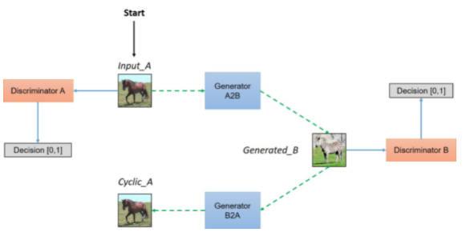
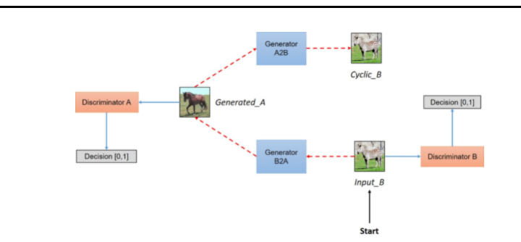

Slide 16
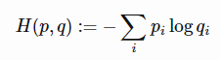
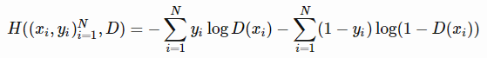
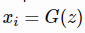
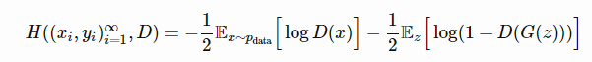
Adversarial Loss
Recall cross entropy between two distributions P and Q:
Thus, for one data point x1 and it’s label y1, we the loss:
Summing over the entire dataset of N samples we get:
In the case of GANs, our Xi’s only come from two sources, either:
, the true data distribution, or , where
Plugging everything up we get:

Slide 17
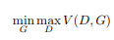
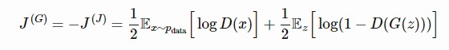
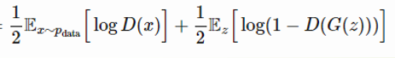
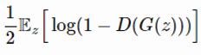
The discriminator minimizes, and the generators maximizes it, taking (-) over the previous expression we get:
Breaking the objective –
Discriminator maximizes:
Generator minimizes:
D maximizes when D(x) → 1, and when D(G(z)) → 0.
G minimizes when D(G(z))→1.

Slide 18
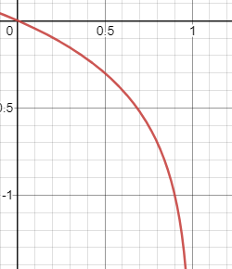
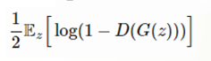
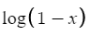
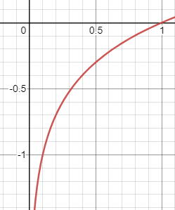
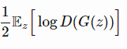
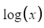
Saturation problem – occurs when gradients
are too small, thus we get almost no learning
progress at all.
In regard to our generator objective:
At D(G(z))=X→ 0 , gradient of log(1-x) is small.
And we want greater gradients where our model fails.
Solving saturation – We modify our generator’s
objective into:
And now when generator fails, greater
gradients are achieved.

Slide 19
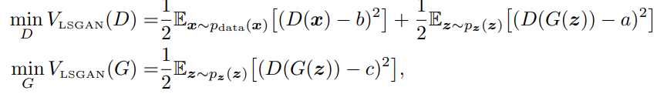
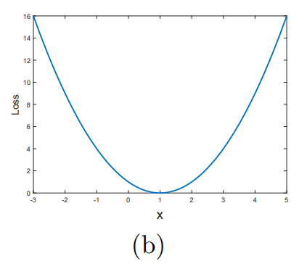
Lease Squares GAN Loss
The least squares loss (Xudong Mao, 2016) is an approach based on the observation of the limitations using binary-cross-entropy loss when generated images are very different from real images.
Where a, b are the labels for fake and real data.
and c denotes the value that G wants D to believe
for fake data.

Slide 20
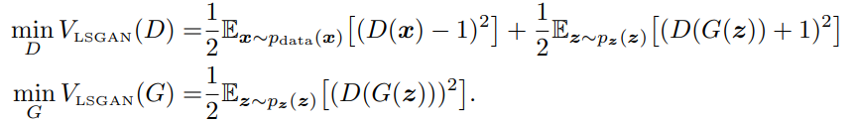
Minimizing this objective yields minimizing Pearson divergence, if a, b and c satisfy the conditions of b-c=1 and b-a=2.
By choosing a=-1, b=1, c=0, we get:

Slide 21
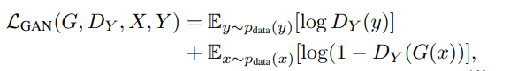
Adversarial Loss in CycleGAN
We apply adversarial losses to both mapping functions, for the mapping function, and it’s discriminator Dy we express the objective as:
Recall that G aims to minimize, against D which maximizes, thus:

Slide 22
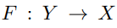
And we introduce similar adversarial loss for the 2nd mapping function and it’s discriminator Dx :

Slide 23
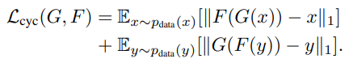
Cycle Consistency Loss
For each image x from domain X, we want –
Forward loss:
For each image y from domain, Y we want –
Backward loss:
Plugging it together we get (using L1 norm):
* The distance metric can be changed per task.

Slide 24
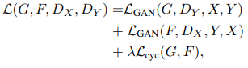
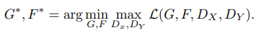
Full objective function
The full objective is:
Where Lambda controls the relative importance of the two objectives, We aim to solve:

Slide 25
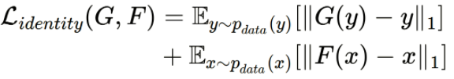
Breaking down the objective into Training
Discriminator are trained, according to:
Lgan1 + Lgan2 , with generators’ weights frozen.
Generators are trained, according to:
Lgan1+Lgan2+ForwardCycleLoss+BackwardCycleLoss
with discriminators’ weights frozen.
* In the paper they replaced the log-likelihood objective by a least squares loss, and in some tasks added Identity loss.

Slide 26
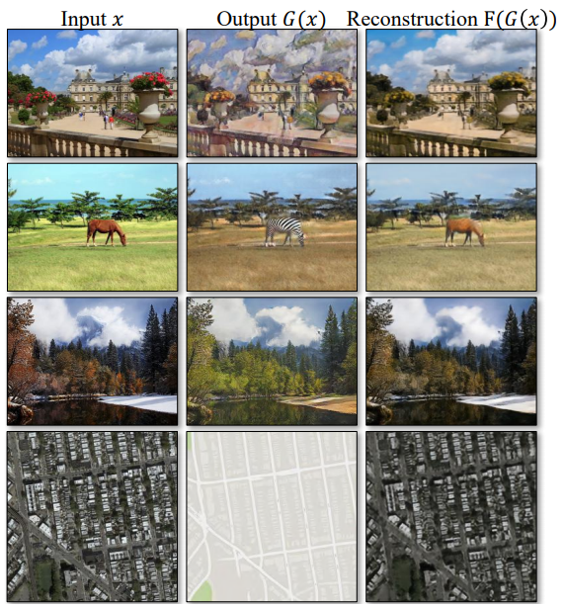
Some visualization
From top to bottom
Photo:Cezanne
Horses:Zebras
Winter:Summer
Aerial Photos: Google Maps

Slide 27
Architecture Implementation

Slide 28
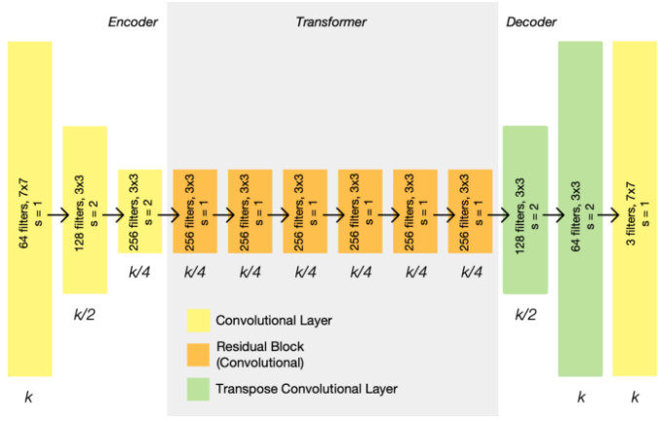
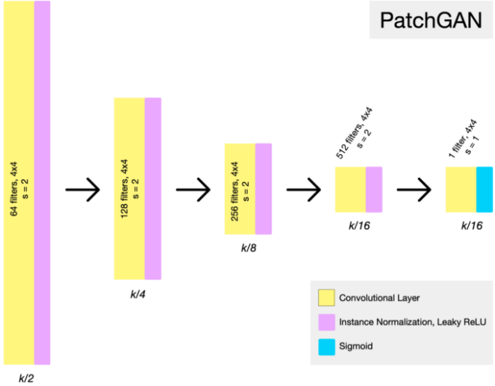
Implementation (Gen’ & Disc’)
Similarly to Pix2Pix architecture, the CycleGAN architecture is built of modified encoder-decoder as a generator, and modified PatchGan as discriminator.

Slide 29
Generator
The Encoder, is responsible for down
scaling in multiple resolutions
The Transformer (bottleneck), forces the model to learn a compression of the original image.
The Decoder, is responsible for up sampling. and due to loss of
localization, skip-connections are added from the Encoder respectively.

Slide 30
Discriminator
Similar to the encoding path
Of the Generator, with the use
Of Instance Normalization layers.
It outputs a 30x30 output-map, where every cell corresponds to 70x70 input overlapping patches, and the discriminator outputs values [0,1] (fake/real) for every cell.

Slide 31
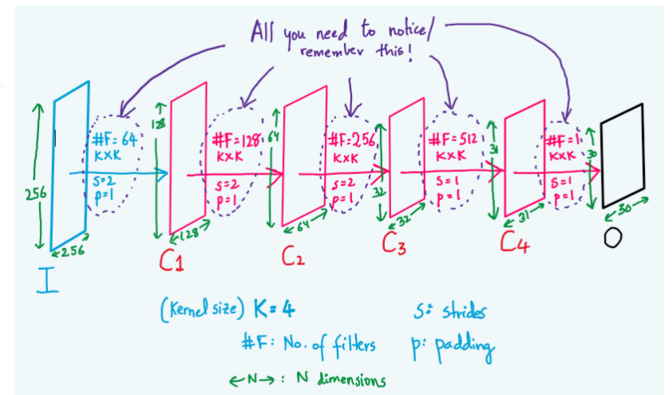
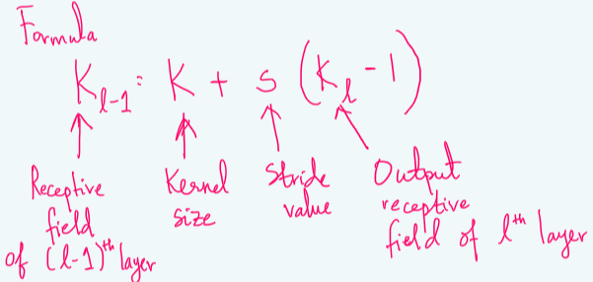
Understanding the output layer
Starting from the last layer, with K=4, S=1, K(L) = 1, we get K(L-1)=4 (hence 4x4 receptive field from layer 3)
And the receptive field for layer L-1 is: 7x7, since K=4, S=1, K(L-1)=4, so we get K(L-2) = 7.
Going back towards the 1st layer, we finally get a receptive field of size 70x70, for every cell in the output layer.

Slide 32
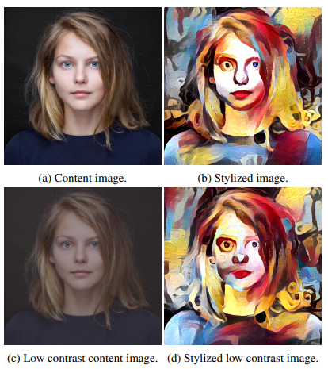
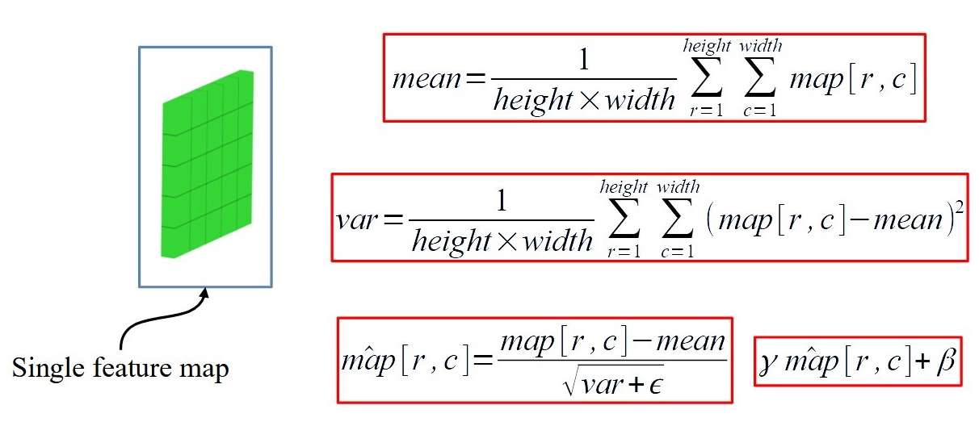
Instance Normalization
This technique is originally devised for style-transfer, and the problem it tries to address is that the result of stylization should not, in general, depend on the contrast of the content image.

Slide 33
Evaluations

Slide 34
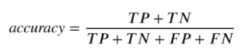
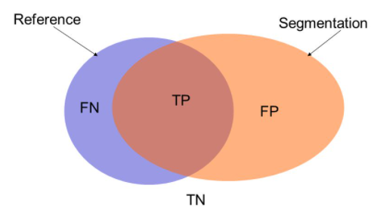
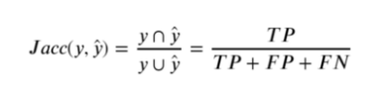
Evaluation – Metrics & Baselines
AMT – Amazon mechanical Turk – 25 participants, 40 pairs of images (generated, real), required to determine which is real (% Turkers labeled real = #of fooled participants).
FCN score – automatic evaluation, this score estimates how the generated images are interpretable based on pre-trained models that perform semantic segmentation.
The FCN predicts a label map for a generated photo, this label map can then be compared against input ground truth labels using standard semantic segmentation metrics (per-pixel accuracy, per-class accuracy, mean class IoU).

Slide 35
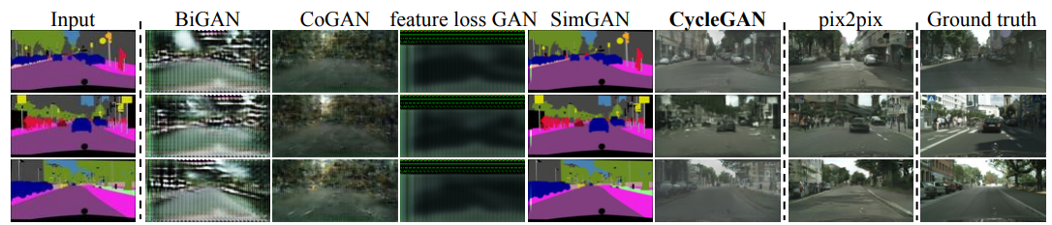
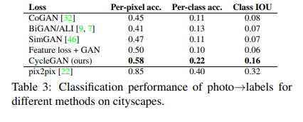
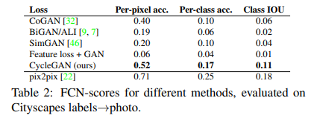
Evaluation – Results over baselines
* The CycleGAN can produce translation that are often of similar quality to the fully supervised Pix2Pix

Slide 36
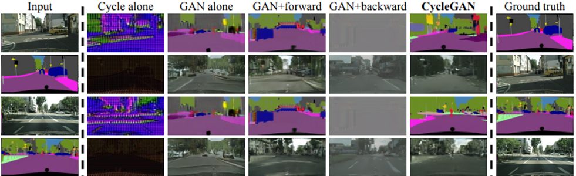
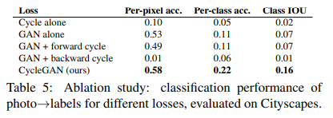
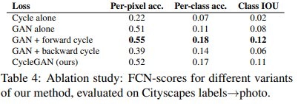
Evaluation – Analyzing loss functions
Removing the GAN loss substantially degraded results, as does removing the cycle consistency loss.
When using only one-sided cycle loss, it often incurs training instability and causes mode-collapse especially for the direction of the mapping that was removed.

Slide 37
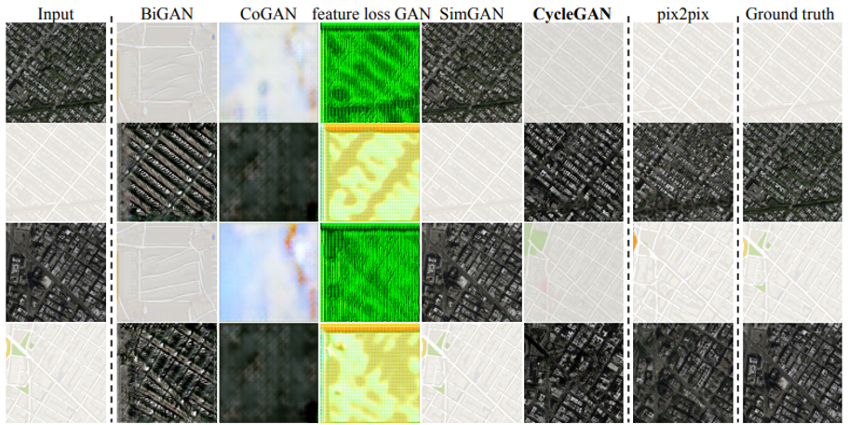
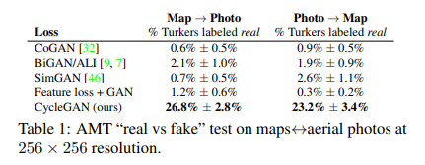
Evaluation - Results

Slide 38
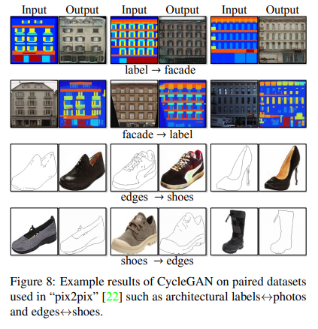
Evaluation – Results over paired-datasets

Slide 39
Applications – over unpaired datasets

Slide 40

Applications –
Collection style transfer – The model is trained over Flickr dataset which contains landscape photographs against works of different artists, attempting to mimic their style.

Slide 41

Applications –
Object transfiguration – The model is trained to translate one object class from ImageNet dataset to another.

Slide 42

Applications –
Season transfer – The model is trained on around 1200 winter and 900 summer photos of Yosemite (From Flickr dataset).

Slide 43

Applications –
Photo generation from paintings – For this task, they found it is helpful to introduce additional loss to encourage the mapping to preserver color composition between the input and output, by applying Identity Loss.
Without it, the generator G and F, are free to change the tint of input images when there is no need to.

Slide 44

Applications –
Photo Enhancement – The model is trained over flower photos from Flickr dataset, where source domain consists of flower photos taken by smartphones, and the target contains photos captured by DSLRs.

Slide 45

Limitations –
Typical failure cases – On tasks that require geometric changes, only little success is achieved, for example, the Cat->Dog transfiguration.
Distributed characteristics of the training datasets – For example, the horse->zebra case, the bizarre output is because the dataset doesn’t contain images of a person riding a horse/zebra.

Slide 46
References

Slide 47
References
https://wiseodd.github.io/techblog/2017/02/18/coupled_gan/ cogan
https://arxiv.org/pdf/1703.10593.pdf cyclegan paper
https://sahiltinky94.medium.com/understanding-patchgan-9f3c8380c207 patchgan
https://arxiv.org/pdf/1611.04076.pdf least-square gan paper
https://danieltakeshi.github.io/2017/03/05/understanding-generative-adversarial-networks/ adversarial loss
https://arxiv.org/pdf/1607.08022.pdf instance normalization
https://towardsdatascience.com/image-segmentation-choosing-the-correct-metric-aa21fd5751af evaluation metrics

